Slide 1
Shield Insurance Business Insights
By: Lohitha Mada

Slide 2
Contents
Company Overview
Objective
About Data
Overview of Dashboard
Recommendations

Slide 3
Company Overview
Shield Insurance provides reliable and comprehensive insurance plans for people of all ages and for businesses.
The company focuses on customer satisfaction and security to make their customers feel safe and protected.

Slide 4
Objective
Design a dashboard to guide Shield Insurance in making informed decisions.
Create a presentation to help them understand dashboard navigation and highlight key insights.

Slide 5




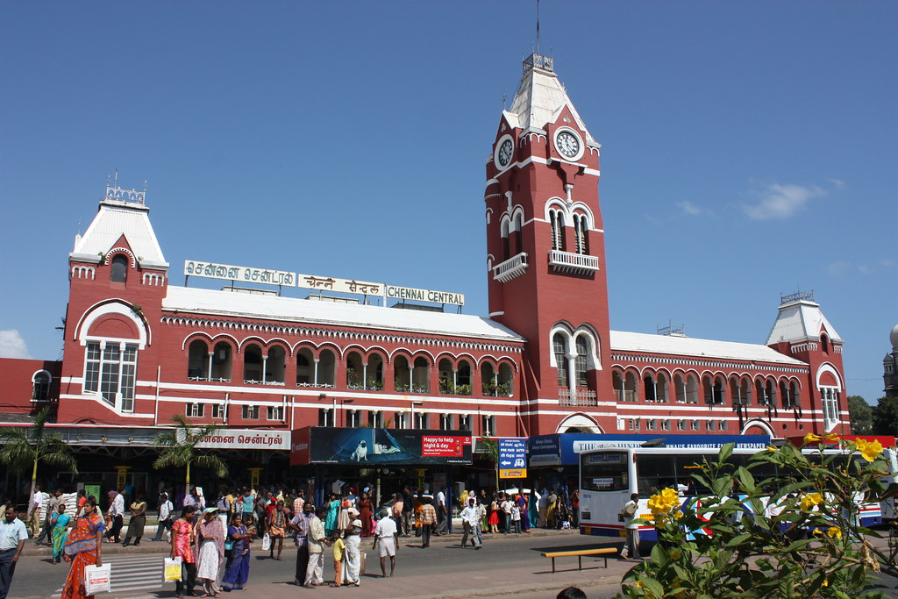
About Data
Shield Insurance Operates in five major cities.
Delhi NCR
Mumbai
Indore
Hyderabad
Chennai

Slide 6
About Data
Reaches customers via four unique sales channels.
Channels
Offline Agent
Offline Direct
Online
App
Online Website

Slide 7
About Data
Policies Offered by Shield Insurance.
Policy Ids
POL6303HEL
POL6093HEL
POL9221HEL
POL1048HEL
POL2005HEL
Policy Ids
POL4321HEL
POL4331HEL
POL3309HEL
POL5319HEL

Slide 8


Dashboard

Slide 9
Recommendations
Increase Presence in Delhi and Other Key Cities: Since Delhi is the top revenue city, more efforts should be made to grow in this market and also expand in cities like Mumbai and Hyderabad.
Enhance Digital Presence: Improving the app and website can provide a great opportunity to increase sales along with offline methods.

Slide 10
Recommendations
Focus on Young Adult Customers: Since adults aged 18-35 generate the less revenue, marketing should aim to attract and keep these customers.
Promote Popular Policies: Focus on marketing successful policies like "POL4321HEL" to attract more customers.

Slide 11
Recommendations
Increase Presence in Delhi and Other Key Cities: Since Delhi is the top revenue city, more efforts should be made to grow in this market and also expand in cities like Mumbai and Hyderabad.
Understand Monthly Changes: Look into the reasons for the significant drop in April 2023 to avoid similar issues in the future and maintain steady growth.

Slide 12


Thank You!

